Slide 1
The Artificial Intelligence trainer
เทรนเนอร์ อัจฉริยะ
Presented by: Aditep Campira

Slide 2
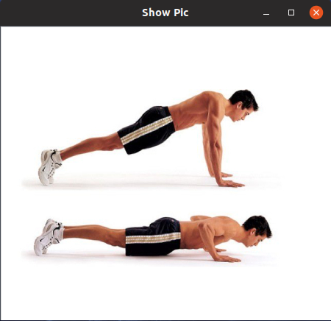
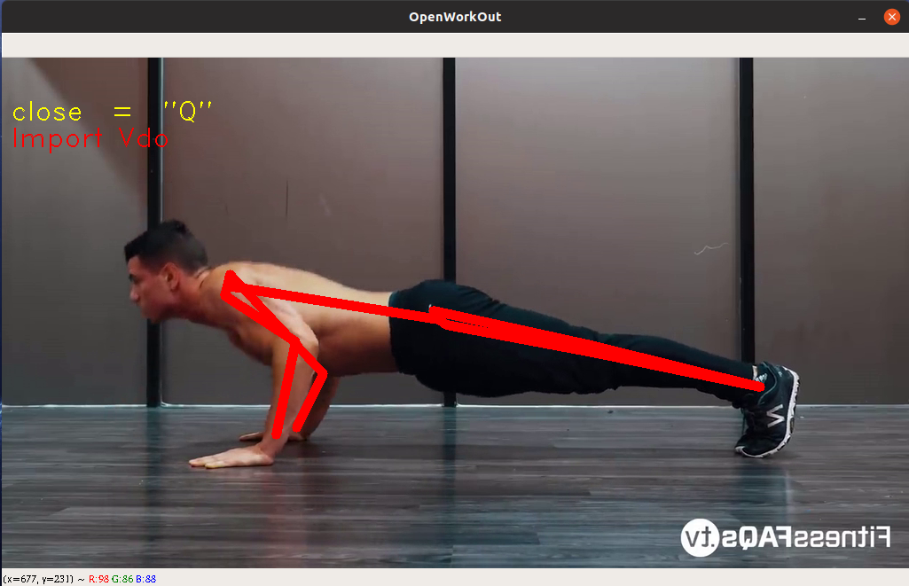
ท่าอะไร ?
ท่า Pushup

Slide 3
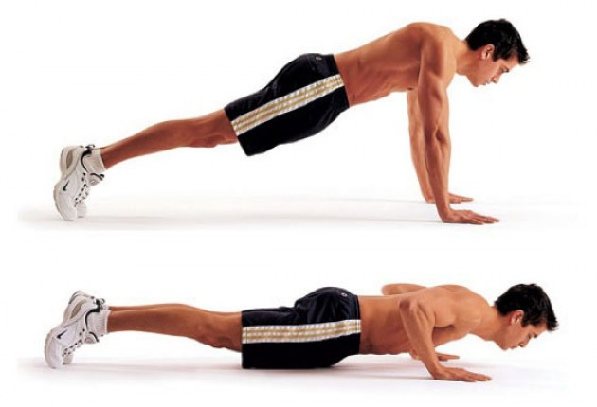
เล่นถูกไหม ?
PUSH-UP
PUSH-UP

Slide 4
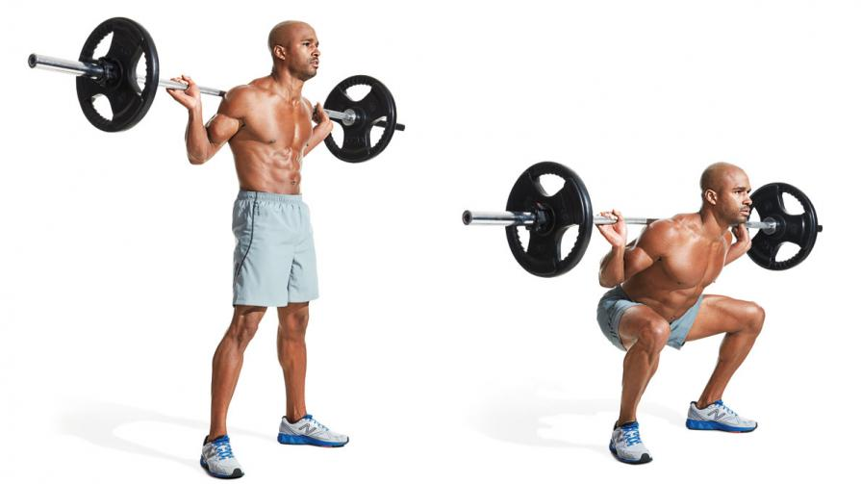
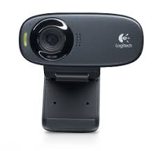
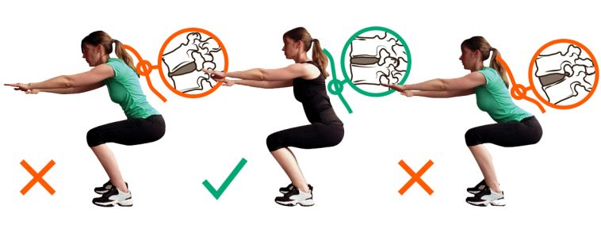
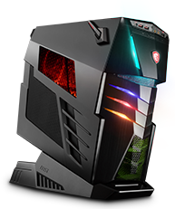
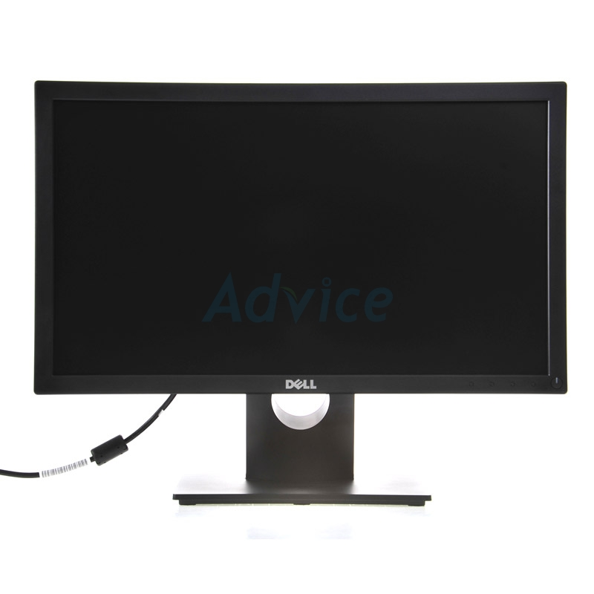
Input
(Webcam , Pictures , Vdo)
(Desktop application)
Process
(AI)
Output

Slide 5
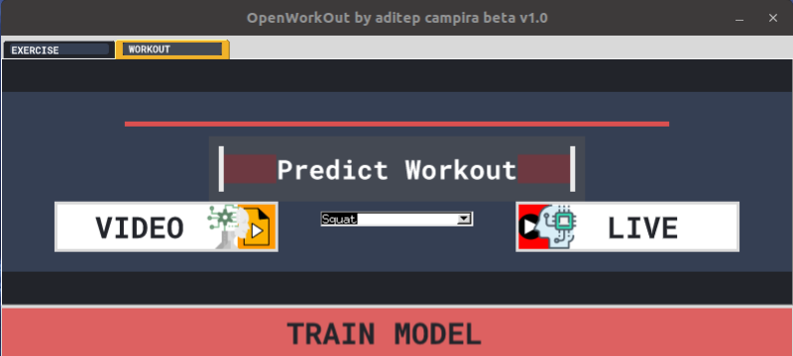
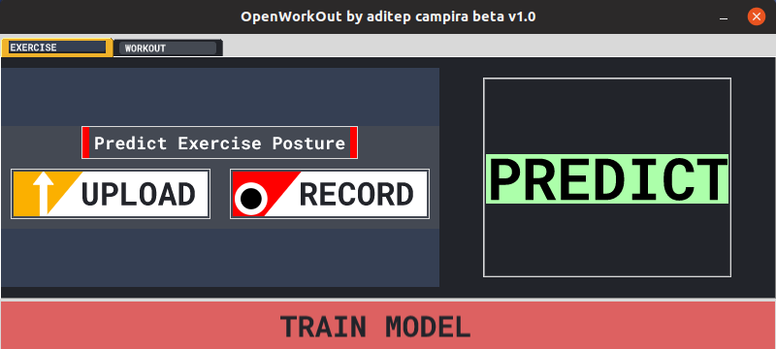
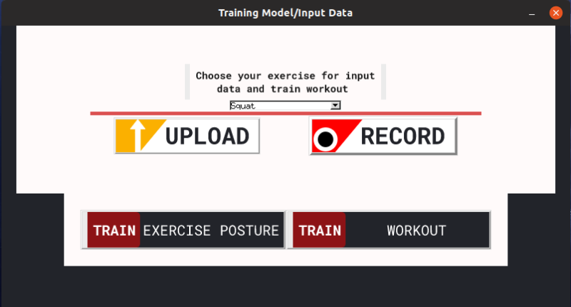
ตรวจสอบความถูกต้อง การเคลื่อนไหว
ทำนายชื่อ ท่าออกกำลังกาย
input data / Train model

Slide 6
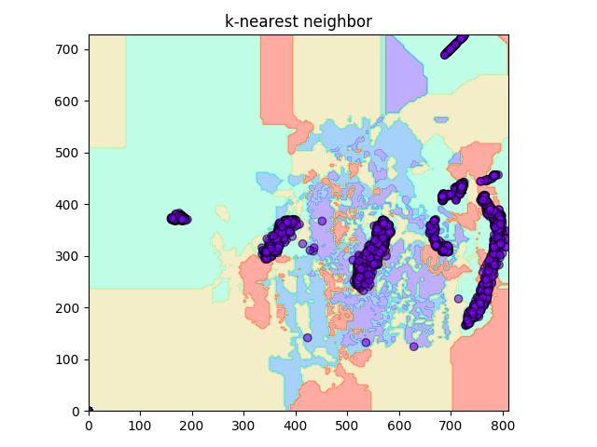
Dumbbell shoulder press
Barbell Curl
Dead lift
Pushup
Squat

Slide 7
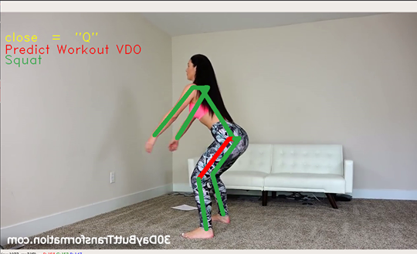
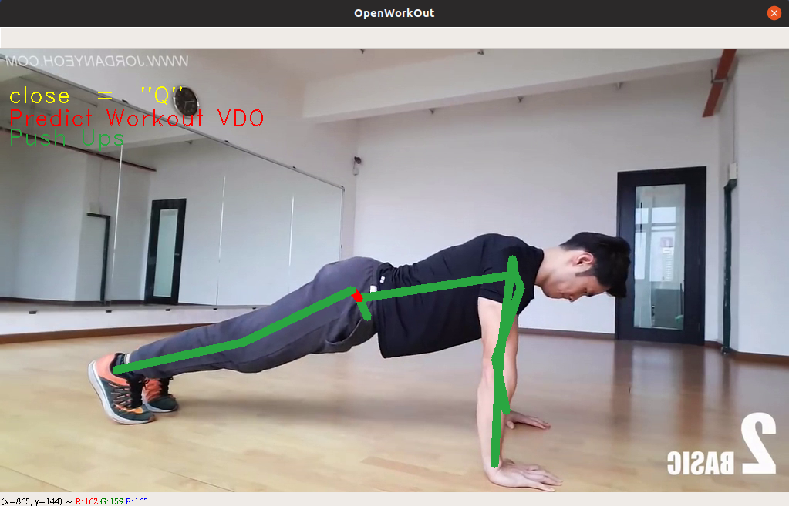
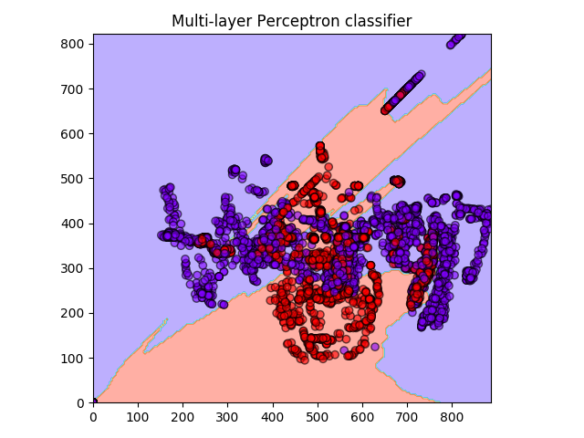
Predict
VDO
OpenCv+Openpose
KeyPoints
dataset
Model
keypose.0.json
training
Predict
matplotlib.pyplot
sklearn.neural_network
[0 0 0 0 0 0 1 0 0 0 0 0 0 0]
ผิด
ถูก
Model
cv2.line

Slide 9
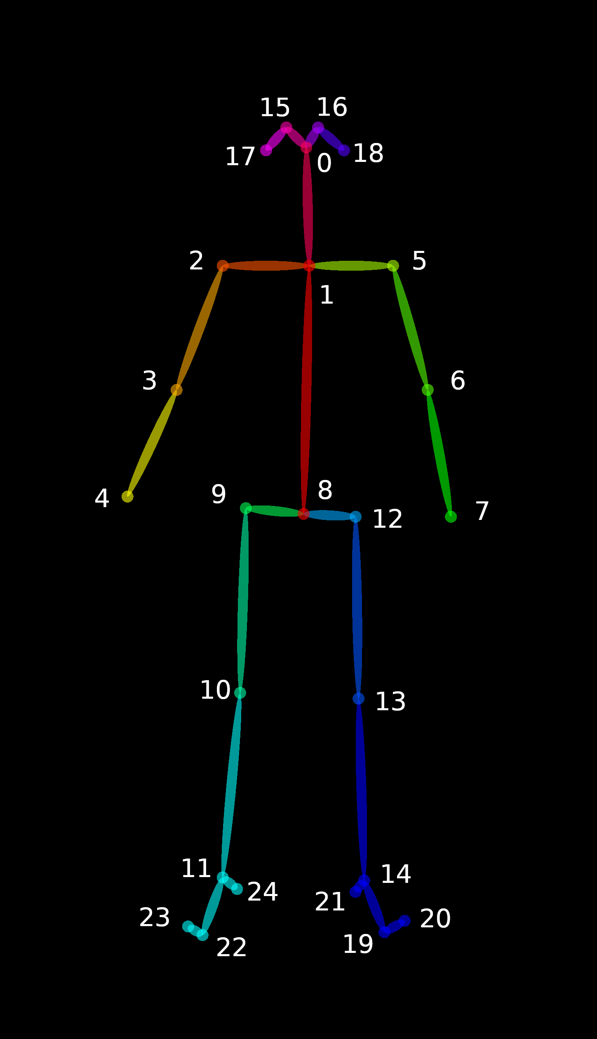
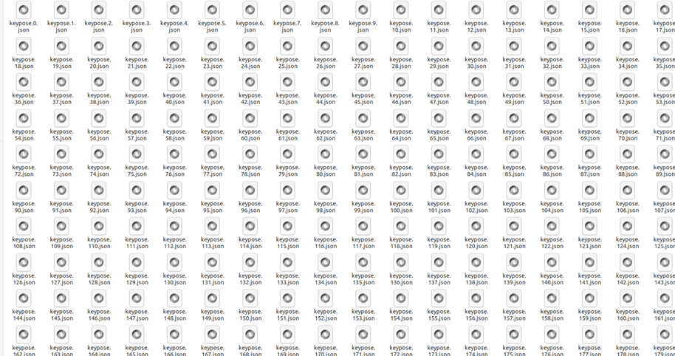
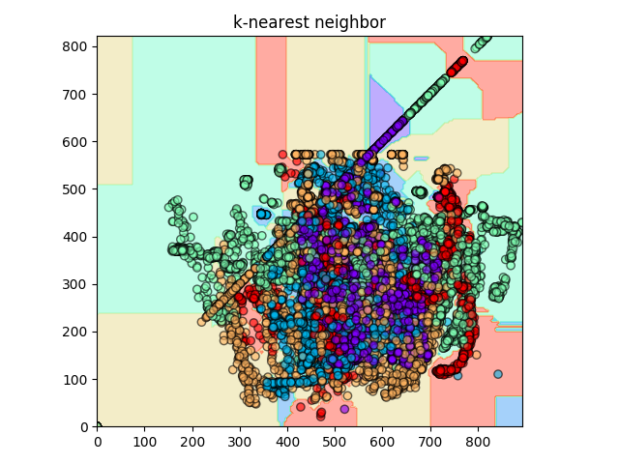
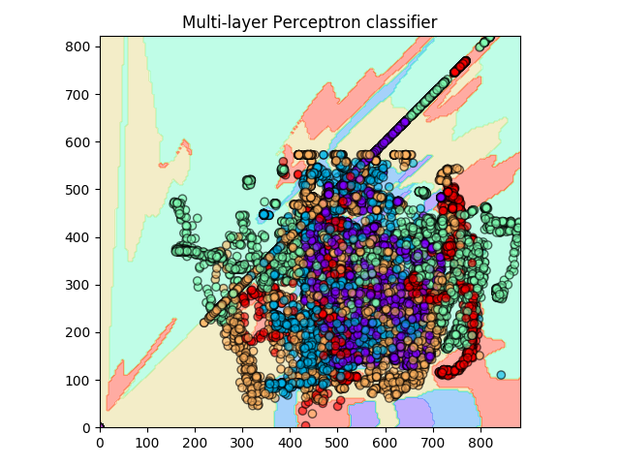
Video
Webcam
keypose.0.json
OpenCv + Openpose
Key Points
dataset
scikit-learn
Algorithms
k-nearest neighbor
Multilayer perceptron classifier
Multilayer perceptron classifier
C-Support Vector
RandomForest
DecisionTree
K - means
k-nearest neighbor
accuracy_score = 0.7322513591301567
accuracy_score = 0.666053725615606

Slide 10
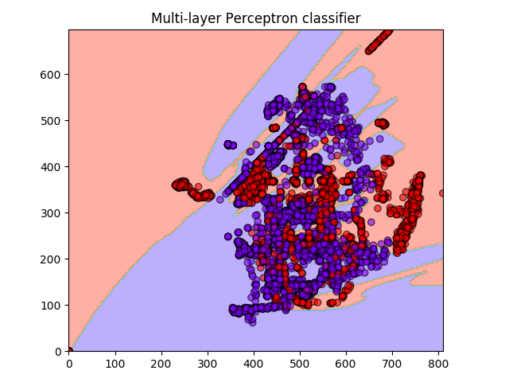
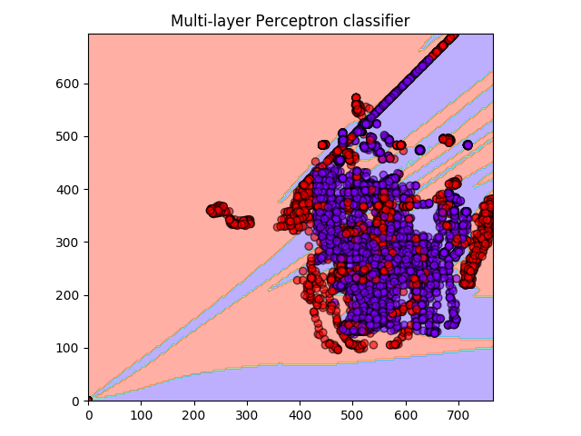
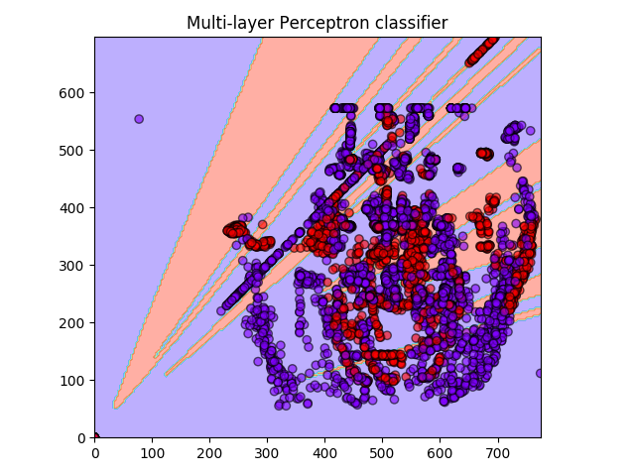
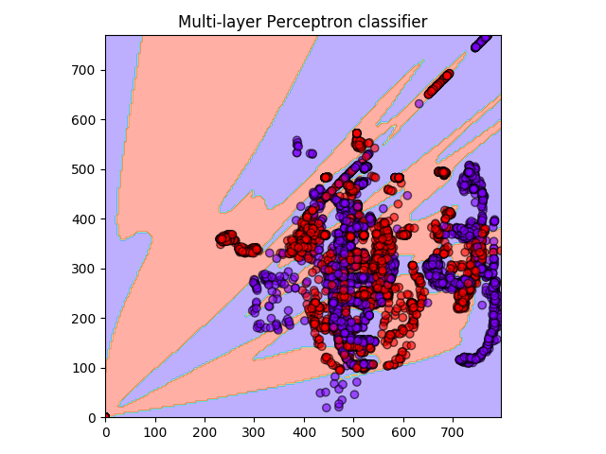
Multilayer perceptron classifier
Barbell Curl
Pushup
accuracy_score = 0.8398814749780509
accuracy_score = 0.7321693121693121
Squat
accuracy_score = 0.7964561145795079
Dumbbell shoulder press
Dead lift
accuracy_score = 0.635881202867517
accuracy_score = 0.8371520078837152

